Slide 1
Solubility
solubility
A. The _______ of a substance is the amount of that substance required to form a saturated solution with a specific amount of the solvent at a specific __________.
temperature

Slide 2
Solubility
1. A ________ solution is a solution that contains the maximum amount of dissolved solute.
saturated

Slide 3
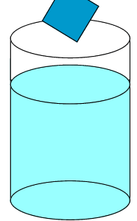
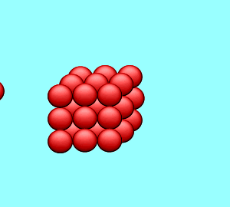
Solubility

Slide 4
Solubility
2. An __________ solution is a solution that contains less solute than a saturated solution under the same conditions.
unsaturated

Slide 5
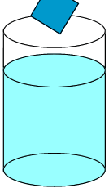
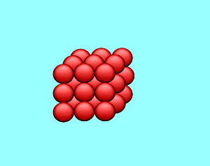
Solubility

Slide 6
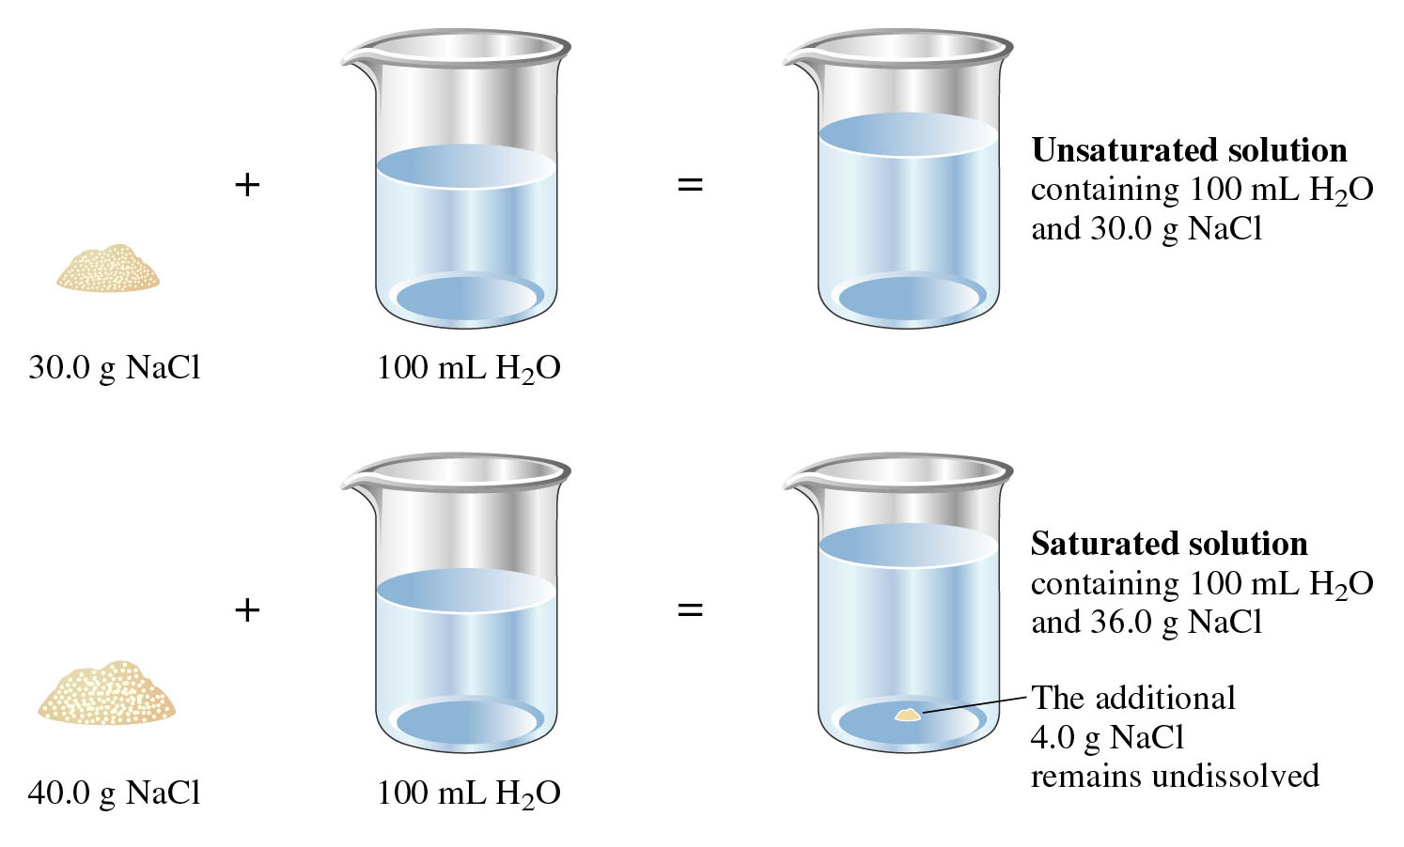
Solubility

Slide 7
Solubility
3. A _____________ solution is a solution that contains more dissolved solute than a saturated solution under the same conditions.
supersaturated

Slide 8
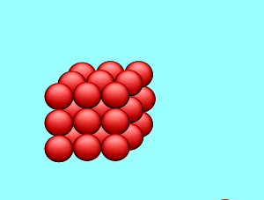
Solubility

Slide 9
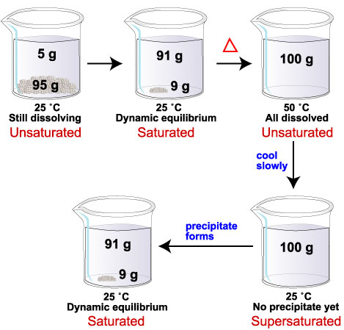

Slide 10
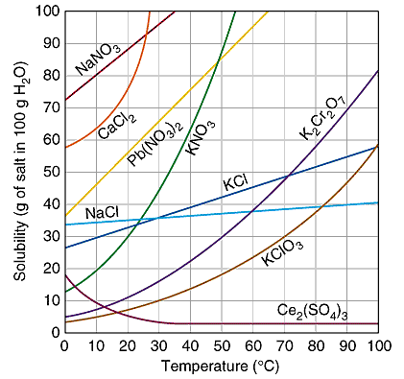

Slide 11
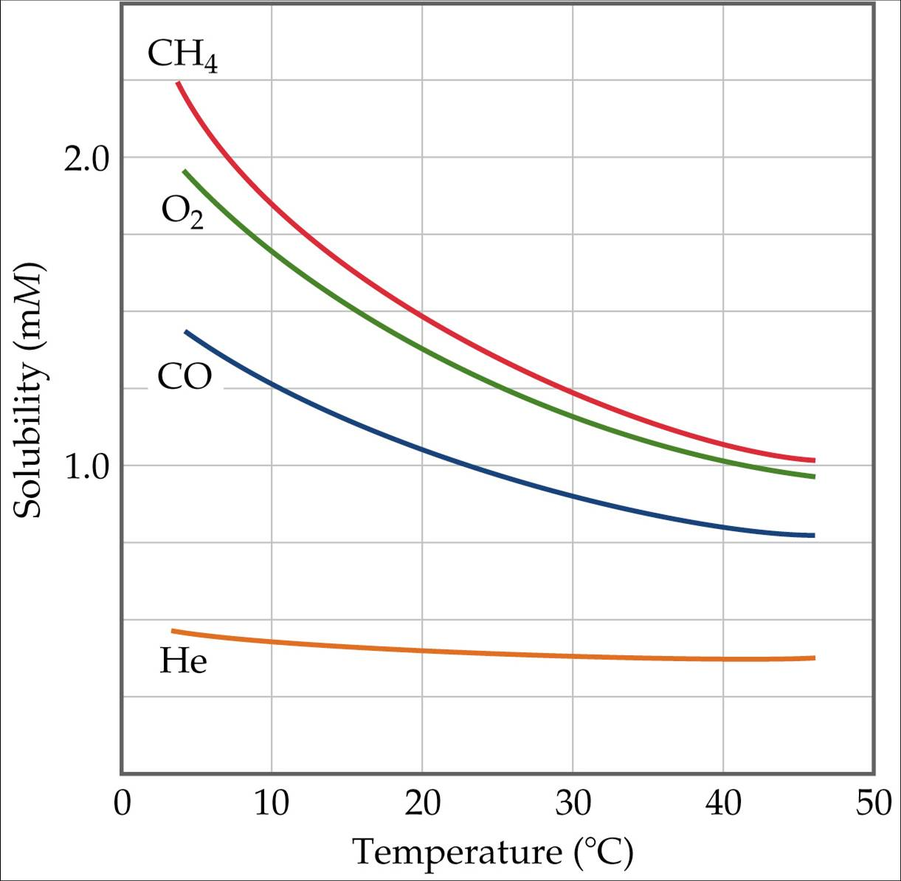
Solubility

Slide 12
Solubility
A. The line on the graph indicates the point at which you have a _________ solution of the solute indicated.
saturated

Slide 14
Solubility

Slide 15
Solubility
1. Any point below this line would indicate an ___________ solution.
unsaturated

Slide 17
Solubility
2. Any point above this line would still indicate a saturated solution, but one that contains ___________ solute equal to the difference between the point above the line until the point on the line at a given temperature.
undissolved

Slide 19
Solubility

Slide 20
Solubility
A. Recall that the process of dissolution is dependent upon the forces of _________ between the solute and solvent particles.
attraction

Slide 21
Solubility
Each solute is made up of different particles that have different strengths of attraction.

Slide 22
Solubility
1. If the solute-solvent attractions aren’t ________ than the solute-solute attractions, the solute will not dissolve and the solution will not form
stronger

Slide 23
Solubility
2. You are provided with a list of _______ ions, things that will generally dissolve, and ________ ions, things that will NOT generally dissolve, on your formula chart.
soluble
insoluble

Slide 24
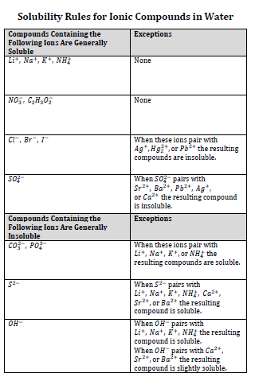
Solubility

Slide 25
Solubility
Pressure
A. ________ affects the solubility of gases in liquids.

Slide 26
Solubility
increase
1. An ________ in pressure will increase the solubility of a gas.

Slide 27
Solubility
Temperature
B. ____________ affects the solubility of gases and solids in liquids.

Slide 28
Solubility
increase
1. An ________ in temperature will decrease solubility of the gas.

Slide 29
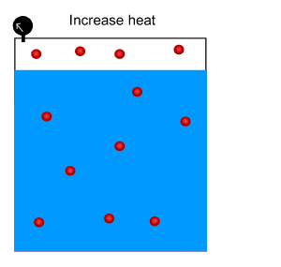
Solubility

Slide 30
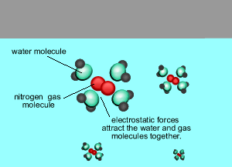
Solubility

Slide 31
Solubility

Slide 32
Solubility
increase
2. An ________ in temperature will usually increase the solubility of a solid.

Slide 33
Solubility
bonding
polarity
A. The type of ________, ________, and _______________ forces will also determine solubility. “__________________” is a rough but useful rule for predicting whether one substance will dissolve in another.
intermolecular
Like dissolves like

Slide 34
Solubility
1. Liquid solutes and solvents that are not soluble in one another are said to be __________.
immiscible

Slide 35
Solubility
2. Liquids that dissolve freely in one another are said to be ________.
miscible

Slide 36
